Slide 1


World Intellectual Property Organization Technological Capacity Building
Transfer of Technology

Slide 2
Think of an app, tool, or IT system you use daily. Was it created in Bhutan or transferred from somewhere else? How did it reach you?

Slide 3
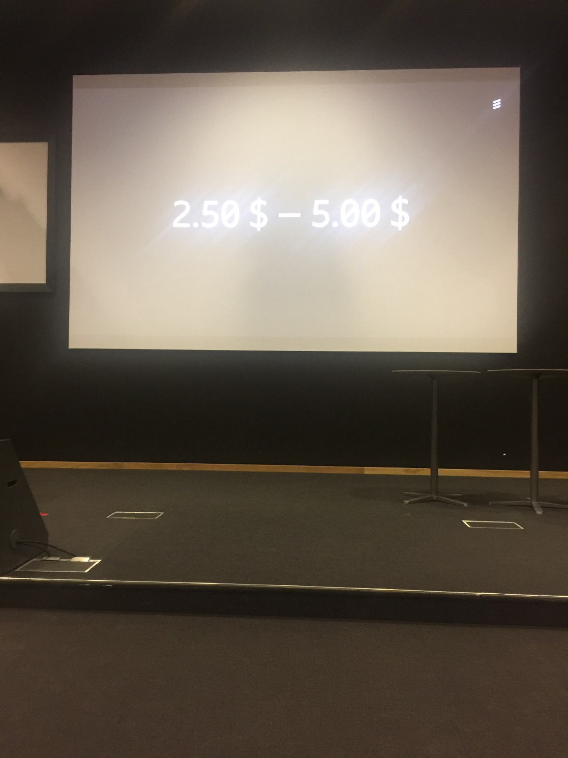

Slide 4


TRANSFER OF TECHNOLOGY
What’s tech?
What is it & How is it important?
LDCs &
Tech Transfer
I. What is Technology?
II. The LDCs & Technology Transfer
Concept of AP
III. Concept of Appropriate Technology (AP)
IV. Appropriate Technology at a Glance
AP at a glance
V. What are the Roles of WIPO?
Role of WIPO
Notes:
The RTG has decided on basic parameters for the range of solutions to be considered:
Utilize private sector, profit motivation and market forces to attract investment, technology and forward looking, professional management.
Align the incentives among the incumbent farmers, the RTG and the agribusinesses in order to reduce risk.
Organizing the farmers and Agricultural Sponsors (agribusinesses) into companies and/or contractual arrangements that operate through the full value chain will facilitate participation of targeted households in the market opportunities.
Provide farmers with the following:
-Incentives to participate in restoring and working the land over the long term;
-A significant share of the increase in income that will result from enhancing the productivity of the land and sustainability of farming practices;
-Safety nets to insure that their income does not fall below current levels, and to insure that their long term leasehold interest in the land is protected. -For example, the corporate parent of each of the private AG Sponsors who join hands with the farmers to improve and work a sub-parcel of the land, will guarantee that farmers' land lease rights are protected at all times. In an event of default, the farmers’ sub lease to the AG Sponsor or to the co-owned entity (ProducerCo) shall be returned to the farmers. The sublease to the ProduceCos will be kept at a third party escrow company.
Governance, to insure performance and adherence to the pledges made by all of the stakeholders, including framers who have a land lease from the Treasury Department;
Participation in governance of the entities which control the farm to market operations, and which oversee the operators;
Guaranteed employment of everyone in the farmer's household who are beyond school-going age.

Slide 5



What’s tech?
What’s Technology?
Knowledge embodied in a physical component, knowhow-knowledge
as well as how it is used and applied.
LDCs &
Tech Transfer
> Physical Component includes
Products
Blueprints
Tools
Techniques
Equipment
Processes
Concept of AP
> Why it’s important?
connected with obtaining certain results, resolving certain problems.
completing certain tasks using particular skills, employing knowledge and exploiting assets.
> Mainstream of Modern Culture considers Technology as
AP at a glance
one of the answers to most problems facing human beings or business or industry.
the potential to improve speed, quality and efficiency of doing things.
the way a business can emerge from the past and enter a brighter, more efficient future.
Role of WIPO
Technology & knowledge are widely recognized as the key factors
in fostering and ensuring sustainable development of countries.
Notes:
The RTG has decided on basic parameters for the range of solutions to be considered:
Utilize private sector, profit motivation and market forces to attract investment, technology and forward looking, professional management.
Align the incentives among the incumbent farmers, the RTG and the agribusinesses in order to reduce risk.
Organizing the farmers and Agricultural Sponsors (agribusinesses) into companies and/or contractual arrangements that operate through the full value chain will facilitate participation of targeted households in the market opportunities.
Provide farmers with the following:
-Incentives to participate in restoring and working the land over the long term;
-A significant share of the increase in income that will result from enhancing the productivity of the land and sustainability of farming practices;
-Safety nets to insure that their income does not fall below current levels, and to insure that their long term leasehold interest in the land is protected. -For example, the corporate parent of each of the private AG Sponsors who join hands with the farmers to improve and work a sub-parcel of the land, will guarantee that farmers' land lease rights are protected at all times. In an event of default, the farmers’ sub lease to the AG Sponsor or to the co-owned entity (ProducerCo) shall be returned to the farmers. The sublease to the ProduceCos will be kept at a third party escrow company.
Governance, to insure performance and adherence to the pledges made by all of the stakeholders, including framers who have a land lease from the Treasury Department;
Participation in governance of the entities which control the farm to market operations, and which oversee the operators;
Guaranteed employment of everyone in the farmer's household who are beyond school-going age.

Slide 6




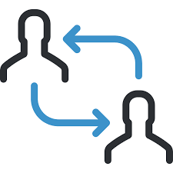

What’s tech?
How to acquire Technology?
3 Ways of Acquiring Technology
LDCs &
Tech Transfer
Concept of AP
Develop themselves
Get it from those
that have developed
Get it from information
available in the public domain
AP at a glance
Role of WIPO
Notes:
The RTG has decided on basic parameters for the range of solutions to be considered:
Utilize private sector, profit motivation and market forces to attract investment, technology and forward looking, professional management.
Align the incentives among the incumbent farmers, the RTG and the agribusinesses in order to reduce risk.
Organizing the farmers and Agricultural Sponsors (agribusinesses) into companies and/or contractual arrangements that operate through the full value chain will facilitate participation of targeted households in the market opportunities.
Provide farmers with the following:
-Incentives to participate in restoring and working the land over the long term;
-A significant share of the increase in income that will result from enhancing the productivity of the land and sustainability of farming practices;
-Safety nets to insure that their income does not fall below current levels, and to insure that their long term leasehold interest in the land is protected. -For example, the corporate parent of each of the private AG Sponsors who join hands with the farmers to improve and work a sub-parcel of the land, will guarantee that farmers' land lease rights are protected at all times. In an event of default, the farmers’ sub lease to the AG Sponsor or to the co-owned entity (ProducerCo) shall be returned to the farmers. The sublease to the ProduceCos will be kept at a third party escrow company.
Governance, to insure performance and adherence to the pledges made by all of the stakeholders, including framers who have a land lease from the Treasury Department;
Participation in governance of the entities which control the farm to market operations, and which oversee the operators;
Guaranteed employment of everyone in the farmer's household who are beyond school-going age.

Slide 7
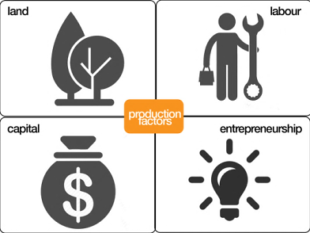
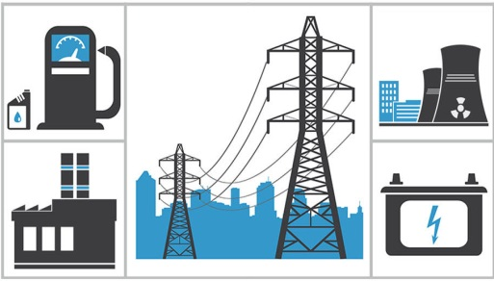



What’s tech?
What’s going on in LDCs?
LDCs have a range of socio-economic problems.
Requires resources
Requires infrastructure
Technology generation takes time
LDCs &
Tech Transfer
Concept of AP
Low indigenous technological capability
Difficult in acquiring technology from the proprietors
AP at a glance
Problems are mainly reflections of technological backwardness
which may be addressed by using technology.
> Reinvent the wheel? -- may not be possible due to inadequate indigenous technological capacity and the challenges in acquiring proprietary technology from technology owners.
> Various technologies that LDCs may need are in the public domain.
-- transferring, adapting, adopting and exploiting technologies developed elsewhere and freely accessible will be a better and viable option.
Role of WIPO
Notes:
The RTG has decided on basic parameters for the range of solutions to be considered:
Utilize private sector, profit motivation and market forces to attract investment, technology and forward looking, professional management.
Align the incentives among the incumbent farmers, the RTG and the agribusinesses in order to reduce risk.
Organizing the farmers and Agricultural Sponsors (agribusinesses) into companies and/or contractual arrangements that operate through the full value chain will facilitate participation of targeted households in the market opportunities.
Provide farmers with the following:
-Incentives to participate in restoring and working the land over the long term;
-A significant share of the increase in income that will result from enhancing the productivity of the land and sustainability of farming practices;
-Safety nets to insure that their income does not fall below current levels, and to insure that their long term leasehold interest in the land is protected. -For example, the corporate parent of each of the private AG Sponsors who join hands with the farmers to improve and work a sub-parcel of the land, will guarantee that farmers' land lease rights are protected at all times. In an event of default, the farmers’ sub lease to the AG Sponsor or to the co-owned entity (ProducerCo) shall be returned to the farmers. The sublease to the ProduceCos will be kept at a third party escrow company.
Governance, to insure performance and adherence to the pledges made by all of the stakeholders, including framers who have a land lease from the Treasury Department;
Participation in governance of the entities which control the farm to market operations, and which oversee the operators;
Guaranteed employment of everyone in the farmer's household who are beyond school-going age.

Slide 8


What’s tech?
Transfer of Technology
Any process by which basic understanding, information, and innovations
move from the owners to the users.
LDCs &
Tech Transfer
Owners
Users
Concept of AP
University
Individual
Individual
Private
Inventor
Institute
Firm
Quasi-private
Government Laboratory
> Why it’s important?
AP at a glance
Allows techniques, knowledge, products, management practices to flow from one to another entity.
Technology is moved for the purpose of exploitation and commercialization.
Results of research and development are transformed into products and new businesses.
Provides a bridge between technology providers and acquirers.
> benefits both parties in terms of business development and growth.
Role of WIPO
However, a foreign technology that is developed and/or used
under a different circumstance may not always be appropriate.
Notes:
The RTG has decided on basic parameters for the range of solutions to be considered:
Utilize private sector, profit motivation and market forces to attract investment, technology and forward looking, professional management.
Align the incentives among the incumbent farmers, the RTG and the agribusinesses in order to reduce risk.
Organizing the farmers and Agricultural Sponsors (agribusinesses) into companies and/or contractual arrangements that operate through the full value chain will facilitate participation of targeted households in the market opportunities.
Provide farmers with the following:
-Incentives to participate in restoring and working the land over the long term;
-A significant share of the increase in income that will result from enhancing the productivity of the land and sustainability of farming practices;
-Safety nets to insure that their income does not fall below current levels, and to insure that their long term leasehold interest in the land is protected. -For example, the corporate parent of each of the private AG Sponsors who join hands with the farmers to improve and work a sub-parcel of the land, will guarantee that farmers' land lease rights are protected at all times. In an event of default, the farmers’ sub lease to the AG Sponsor or to the co-owned entity (ProducerCo) shall be returned to the farmers. The sublease to the ProduceCos will be kept at a third party escrow company.
Governance, to insure performance and adherence to the pledges made by all of the stakeholders, including framers who have a land lease from the Treasury Department;
Participation in governance of the entities which control the farm to market operations, and which oversee the operators;
Guaranteed employment of everyone in the farmer's household who are beyond school-going age.

Slide 9

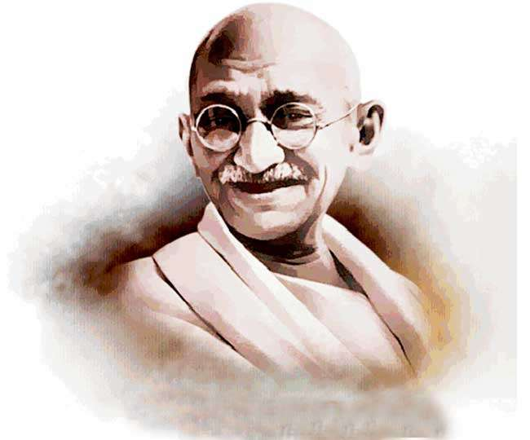
What’s tech?
Concept of Appropriate Technology (AP)
India
LDCs &
Tech Transfer
> Mahatma Gandhi – Father of the AP movement
‘Mechanization is only good when the hands are too few
for the work to be accomplished.’
Founded 2 associations focused on Village-based Technology.
> All-India Spinners Association
1935 > All-India Village Industries Association
Concept of AP
AP at a glance
Role of WIPO
Notes:
The RTG has decided on basic parameters for the range of solutions to be considered:
Utilize private sector, profit motivation and market forces to attract investment, technology and forward looking, professional management.
Align the incentives among the incumbent farmers, the RTG and the agribusinesses in order to reduce risk.
Organizing the farmers and Agricultural Sponsors (agribusinesses) into companies and/or contractual arrangements that operate through the full value chain will facilitate participation of targeted households in the market opportunities.
Provide farmers with the following:
-Incentives to participate in restoring and working the land over the long term;
-A significant share of the increase in income that will result from enhancing the productivity of the land and sustainability of farming practices;
-Safety nets to insure that their income does not fall below current levels, and to insure that their long term leasehold interest in the land is protected. -For example, the corporate parent of each of the private AG Sponsors who join hands with the farmers to improve and work a sub-parcel of the land, will guarantee that farmers' land lease rights are protected at all times. In an event of default, the farmers’ sub lease to the AG Sponsor or to the co-owned entity (ProducerCo) shall be returned to the farmers. The sublease to the ProduceCos will be kept at a third party escrow company.
Governance, to insure performance and adherence to the pledges made by all of the stakeholders, including framers who have a land lease from the Treasury Department;
Participation in governance of the entities which control the farm to market operations, and which oversee the operators;
Guaranteed employment of everyone in the farmer's household who are beyond school-going age.

Slide 10
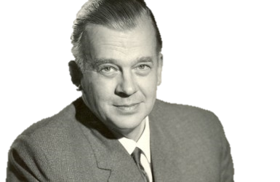
What’s tech?
Concept of Appropriate Technology (AP)
United Kingdom
LDCs &
Tech Transfer
> Dr. Ernst Friedrich Schumacher – Founder of the AP movement
Developed the underlying principles of AP through his work
in India and Burma.
Also influenced by the ideas of Gandhi
Concept of AP
1962 > first articulated the idea of ‘Intermediate Technology’
- now known as ‘Appropriate Technology’.
-- Report to the Indian Planning Commission described India as long in labor
-- McRobie Goerge (1981), Small Is Possible, New York: Harper and Row, ISBN 0-06-013051-5
Initially, both the Indian government and leading development
economists rejected Schumacher’s ideas.
British born economist
AP at a glance
1973 > Published ‘Small is Beautiful: Economics as if People Mattered’
- able to disseminate the concept of AP to a wider mass audience.
-- Schumacher, E.F. (1973): “Small Is Beautiful: Economics As If People Mattered” New York; Harper and Row
1995 > Small is Beautiful was among the 100 most influential books
published since World War II.
-- According to the Times Literary Supplement
Role of WIPO
Notes:
The RTG has decided on basic parameters for the range of solutions to be considered:
Utilize private sector, profit motivation and market forces to attract investment, technology and forward looking, professional management.
Align the incentives among the incumbent farmers, the RTG and the agribusinesses in order to reduce risk.
Organizing the farmers and Agricultural Sponsors (agribusinesses) into companies and/or contractual arrangements that operate through the full value chain will facilitate participation of targeted households in the market opportunities.
Provide farmers with the following:
-Incentives to participate in restoring and working the land over the long term;
-A significant share of the increase in income that will result from enhancing the productivity of the land and sustainability of farming practices;
-Safety nets to insure that their income does not fall below current levels, and to insure that their long term leasehold interest in the land is protected. -For example, the corporate parent of each of the private AG Sponsors who join hands with the farmers to improve and work a sub-parcel of the land, will guarantee that farmers' land lease rights are protected at all times. In an event of default, the farmers’ sub lease to the AG Sponsor or to the co-owned entity (ProducerCo) shall be returned to the farmers. The sublease to the ProduceCos will be kept at a third party escrow company.
Governance, to insure performance and adherence to the pledges made by all of the stakeholders, including framers who have a land lease from the Treasury Department;
Participation in governance of the entities which control the farm to market operations, and which oversee the operators;
Guaranteed employment of everyone in the farmer's household who are beyond school-going age.

Slide 11
What’s tech?
Intermediate Technology Development Group (ITDG)
> The ITDG Team - E.F. Schumacher together with a group of about 20 people
LDCs &
Tech Transfer
E.F. Schumacher
Mansur Hoda
George McRobie
Julia Porter
> Major Contribution
‘Tools for Progress: A Guide to Small-scale Equipment for Rural Development’
(sold 7,000 copies)
Concept of AP
Panels of experts & practitioners around specific technology need
to develop intermediate technologies to address those needs.
1968 > The term ‘Intermediate Technology’ was discarded
in favor of ‘Appropriate Technology’ as today. (At a conference hosted by the ITDG)
AP at a glance
Reason?
Intermediate Technology had been criticized as suggesting the technology
was inferior to advanced (or high) technology and not including the social
and political factors included in the concept put forth by the proponents.
Role of WIPO
Notes:
The RTG has decided on basic parameters for the range of solutions to be considered:
Utilize private sector, profit motivation and market forces to attract investment, technology and forward looking, professional management.
Align the incentives among the incumbent farmers, the RTG and the agribusinesses in order to reduce risk.
Organizing the farmers and Agricultural Sponsors (agribusinesses) into companies and/or contractual arrangements that operate through the full value chain will facilitate participation of targeted households in the market opportunities.
Provide farmers with the following:
-Incentives to participate in restoring and working the land over the long term;
-A significant share of the increase in income that will result from enhancing the productivity of the land and sustainability of farming practices;
-Safety nets to insure that their income does not fall below current levels, and to insure that their long term leasehold interest in the land is protected. -For example, the corporate parent of each of the private AG Sponsors who join hands with the farmers to improve and work a sub-parcel of the land, will guarantee that farmers' land lease rights are protected at all times. In an event of default, the farmers’ sub lease to the AG Sponsor or to the co-owned entity (ProducerCo) shall be returned to the farmers. The sublease to the ProduceCos will be kept at a third party escrow company.
Governance, to insure performance and adherence to the pledges made by all of the stakeholders, including framers who have a land lease from the Treasury Department;
Participation in governance of the entities which control the farm to market operations, and which oversee the operators;
Guaranteed employment of everyone in the farmer's household who are beyond school-going age.

Slide 12
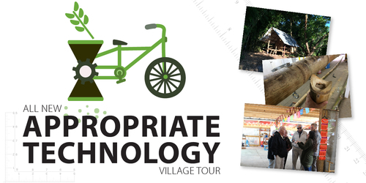

What’s tech?
What’s Appropriate Technology?
Several definitions have been given for the term Appropriate Technology.
As a way of summary, Appropriate Technology is seen as:
LDCs &
Tech Transfer
Simplest level of technology that can effectively
achieve the intended purpose in a given location.
Approach to community development consisting
of knowledge, techniques & underlying philosophy.
Concept of AP
Grassroots' approach to technology that builds
a strong sense of community and encompasses
benefits that span across social, environmental,
cultural, economic, and spiritual facets.
Genuine grassroots solution to economic and
social needs, which works from the bottom up.
> Characteristics
AP at a glance
Making use of skills & technology available in a local community to supply basic human needs.
Not a one size fits all approach, but rather adapts to best fit in the community it is developed.
More labor intensive, require fewer resources & use low cost or readily available materials
wherever possible.
Role of WIPO
Special attention is paid to the social, cultural, & ethical aspects
of the communities the technology is intended for.
Notes:
The RTG has decided on basic parameters for the range of solutions to be considered:
Utilize private sector, profit motivation and market forces to attract investment, technology and forward looking, professional management.
Align the incentives among the incumbent farmers, the RTG and the agribusinesses in order to reduce risk.
Organizing the farmers and Agricultural Sponsors (agribusinesses) into companies and/or contractual arrangements that operate through the full value chain will facilitate participation of targeted households in the market opportunities.
Provide farmers with the following:
-Incentives to participate in restoring and working the land over the long term;
-A significant share of the increase in income that will result from enhancing the productivity of the land and sustainability of farming practices;
-Safety nets to insure that their income does not fall below current levels, and to insure that their long term leasehold interest in the land is protected. -For example, the corporate parent of each of the private AG Sponsors who join hands with the farmers to improve and work a sub-parcel of the land, will guarantee that farmers' land lease rights are protected at all times. In an event of default, the farmers’ sub lease to the AG Sponsor or to the co-owned entity (ProducerCo) shall be returned to the farmers. The sublease to the ProduceCos will be kept at a third party escrow company.
Governance, to insure performance and adherence to the pledges made by all of the stakeholders, including framers who have a land lease from the Treasury Department;
Participation in governance of the entities which control the farm to market operations, and which oversee the operators;
Guaranteed employment of everyone in the farmer's household who are beyond school-going age.

Slide 13






What’s tech?
How is it to be appropriate?
To determine whether a certain technology is appropriate for a specific area or need,
the following questions can be posed:
LDCs &
Tech Transfer
Concept of AP
Resources Utilization
Social Participation
Economic Development
Is it low-cost and efficient?
Is it acceptable to the local people?
Will it help to improve the well-
being of those in greatest need?
Does it make full use of local
resources, traditions, and abilities?
Do/Will they use it effectively?
AP at a glance
Will it help close the gap
between the rich & the poor?
Can local people easily understand,
afford, and repair by themselves?
Does it keep a natural balance
with the environment?
Does it provide more local
employment? Or take jobs away?
To what extent local people involved
or consulted in its planning, design,
selection, or adaptation?
Does it take into consideration
any local factors such as
geography, climate, and traditions,
which may affect its usefulness?
Does it help the weak to gain
greater control and become
more self-reliant?
Role of WIPO
Does it build people's confidence
to find their own answers and
make their own decisions?
Notes:
The RTG has decided on basic parameters for the range of solutions to be considered:
Utilize private sector, profit motivation and market forces to attract investment, technology and forward looking, professional management.
Align the incentives among the incumbent farmers, the RTG and the agribusinesses in order to reduce risk.
Organizing the farmers and Agricultural Sponsors (agribusinesses) into companies and/or contractual arrangements that operate through the full value chain will facilitate participation of targeted households in the market opportunities.
Provide farmers with the following:
-Incentives to participate in restoring and working the land over the long term;
-A significant share of the increase in income that will result from enhancing the productivity of the land and sustainability of farming practices;
-Safety nets to insure that their income does not fall below current levels, and to insure that their long term leasehold interest in the land is protected. -For example, the corporate parent of each of the private AG Sponsors who join hands with the farmers to improve and work a sub-parcel of the land, will guarantee that farmers' land lease rights are protected at all times. In an event of default, the farmers’ sub lease to the AG Sponsor or to the co-owned entity (ProducerCo) shall be returned to the farmers. The sublease to the ProduceCos will be kept at a third party escrow company.
Governance, to insure performance and adherence to the pledges made by all of the stakeholders, including framers who have a land lease from the Treasury Department;
Participation in governance of the entities which control the farm to market operations, and which oversee the operators;
Guaranteed employment of everyone in the farmer's household who are beyond school-going age.

Slide 14

What’s tech?
When it’s not appropriate?
The answer is simply… when those previous criteria are not satisfied.
LDCs &
Tech Transfer
Or
Or
Concept of AP
Resources Utilization
Social Participation
Economic Development
> Sample Case in Kenya
Recently, multinational tea companies in Kenya introduced tea picking machines, in order to reduce on the cost of picking tea and increase its profit.
In this case, the tea-picking machine is not an appropriate technology, as it leads to loss of jobs, though it’s useful in increasing efficiency & reducing costs.
AP at a glance
Role of WIPO
This illustrates that a technology which is not appropriate
does not mean that it is not useful.
Notes:
The RTG has decided on basic parameters for the range of solutions to be considered:
Utilize private sector, profit motivation and market forces to attract investment, technology and forward looking, professional management.
Align the incentives among the incumbent farmers, the RTG and the agribusinesses in order to reduce risk.
Organizing the farmers and Agricultural Sponsors (agribusinesses) into companies and/or contractual arrangements that operate through the full value chain will facilitate participation of targeted households in the market opportunities.
Provide farmers with the following:
-Incentives to participate in restoring and working the land over the long term;
-A significant share of the increase in income that will result from enhancing the productivity of the land and sustainability of farming practices;
-Safety nets to insure that their income does not fall below current levels, and to insure that their long term leasehold interest in the land is protected. -For example, the corporate parent of each of the private AG Sponsors who join hands with the farmers to improve and work a sub-parcel of the land, will guarantee that farmers' land lease rights are protected at all times. In an event of default, the farmers’ sub lease to the AG Sponsor or to the co-owned entity (ProducerCo) shall be returned to the farmers. The sublease to the ProduceCos will be kept at a third party escrow company.
Governance, to insure performance and adherence to the pledges made by all of the stakeholders, including framers who have a land lease from the Treasury Department;
Participation in governance of the entities which control the farm to market operations, and which oversee the operators;
Guaranteed employment of everyone in the farmer's household who are beyond school-going age.

Slide 15
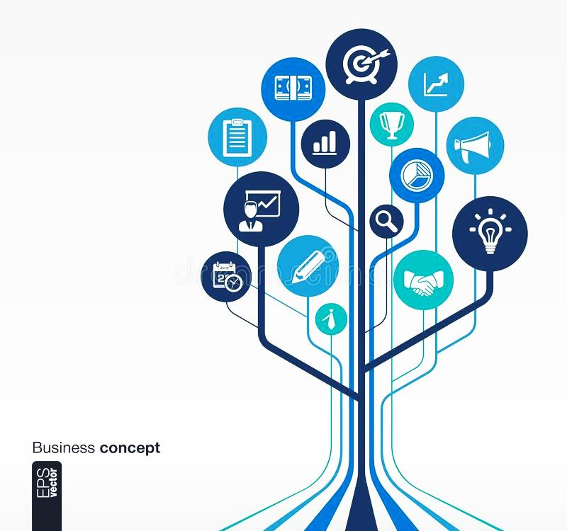
What’s tech?
Why AT is important?
Appropriate technology is important due to its holistic nature & the following reasons:
(Appropriate Technology: Learning from one another - article by Jesse Margus, Tara Nakashima and Chantal Orr)
LDCs &
Tech Transfer
Permits local needs to be met effectively through community
Involvement – tends to be aligned with local values and traditions.
Utilizes human labor by developing tools rather than machines
– enables people to self-organize without complicated management
training and specialized knowledge.
Concept of AP
Minimizes transport of goods – allow greater local participation
& implementation of local resources, both human & material.
Reinforces local control – provides a cushion against the effects
of outside economic changes.
AP at a glance
Establishes self-sustaining skill base – reduces economic, social
and political dependency between individuals, regions and nations.
Recognizes the will of local people
– technology made by & for the people.
Role of WIPO
Benefits of AT can be realized in both Northern and Southern countries,
and plays an undoubtedly critical role in building sustainable communities.
Notes:
The RTG has decided on basic parameters for the range of solutions to be considered:
Utilize private sector, profit motivation and market forces to attract investment, technology and forward looking, professional management.
Align the incentives among the incumbent farmers, the RTG and the agribusinesses in order to reduce risk.
Organizing the farmers and Agricultural Sponsors (agribusinesses) into companies and/or contractual arrangements that operate through the full value chain will facilitate participation of targeted households in the market opportunities.
Provide farmers with the following:
-Incentives to participate in restoring and working the land over the long term;
-A significant share of the increase in income that will result from enhancing the productivity of the land and sustainability of farming practices;
-Safety nets to insure that their income does not fall below current levels, and to insure that their long term leasehold interest in the land is protected. -For example, the corporate parent of each of the private AG Sponsors who join hands with the farmers to improve and work a sub-parcel of the land, will guarantee that farmers' land lease rights are protected at all times. In an event of default, the farmers’ sub lease to the AG Sponsor or to the co-owned entity (ProducerCo) shall be returned to the farmers. The sublease to the ProduceCos will be kept at a third party escrow company.
Governance, to insure performance and adherence to the pledges made by all of the stakeholders, including framers who have a land lease from the Treasury Department;
Participation in governance of the entities which control the farm to market operations, and which oversee the operators;
Guaranteed employment of everyone in the farmer's household who are beyond school-going age.

Slide 16

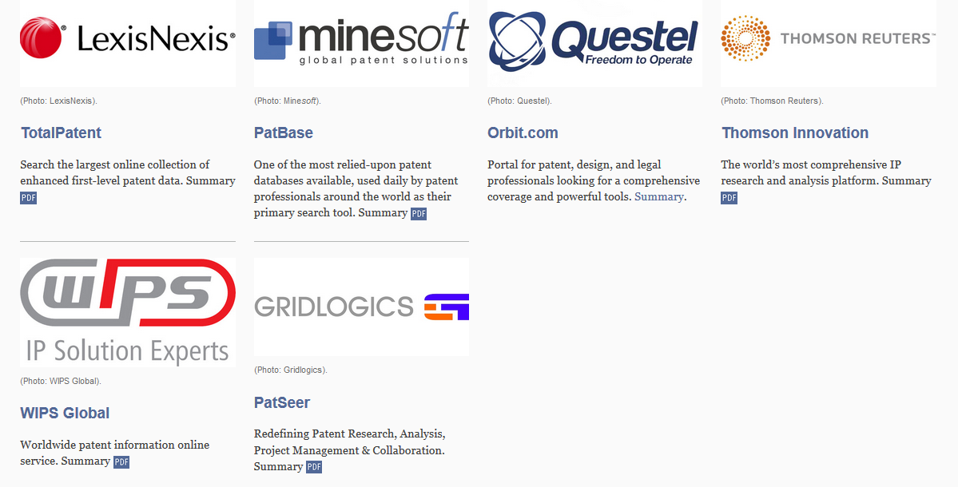
What’s tech?
What are the roles of WIPO?
1
Specialized Patent Information (ASPI) Program
LDCs &
Tech Transfer
Public-private partnership launched in September, 2010 by Dr. Francis Gurry – WIPO DG,
in cooperation with LexisNexis, Minesoft, ProQuest, Questel, Thomson Reuters, WIPS.
Concept of AP
The Partners
AP at a glance
> Access to patent information tools and service.
> Available in all eligible LDC institutions for free.
(patent office or a research or academic institution)
Role of WIPO
Fully exploit their innovative potential by leveraging the valuable information contained in patent documents to develop new solutions
to technical problems faced at the local and international level.
Notes:
The RTG has decided on basic parameters for the range of solutions to be considered:
Utilize private sector, profit motivation and market forces to attract investment, technology and forward looking, professional management.
Align the incentives among the incumbent farmers, the RTG and the agribusinesses in order to reduce risk.
Organizing the farmers and Agricultural Sponsors (agribusinesses) into companies and/or contractual arrangements that operate through the full value chain will facilitate participation of targeted households in the market opportunities.
Provide farmers with the following:
-Incentives to participate in restoring and working the land over the long term;
-A significant share of the increase in income that will result from enhancing the productivity of the land and sustainability of farming practices;
-Safety nets to insure that their income does not fall below current levels, and to insure that their long term leasehold interest in the land is protected. -For example, the corporate parent of each of the private AG Sponsors who join hands with the farmers to improve and work a sub-parcel of the land, will guarantee that farmers' land lease rights are protected at all times. In an event of default, the farmers’ sub lease to the AG Sponsor or to the co-owned entity (ProducerCo) shall be returned to the farmers. The sublease to the ProduceCos will be kept at a third party escrow company.
Governance, to insure performance and adherence to the pledges made by all of the stakeholders, including framers who have a land lease from the Treasury Department;
Participation in governance of the entities which control the farm to market operations, and which oversee the operators;
Guaranteed employment of everyone in the farmer's household who are beyond school-going age.

Slide 17
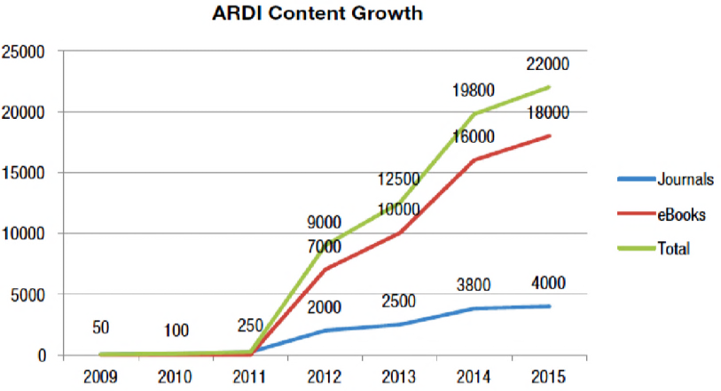
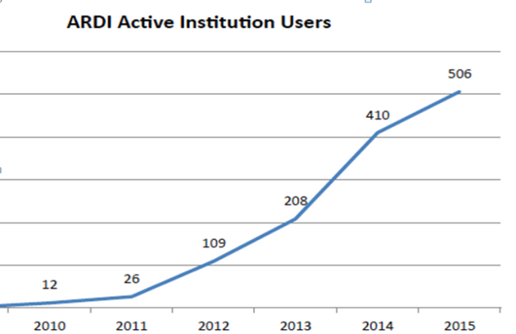
What’s tech?
What are the roles of WIPO?
2
Research for Development and Innovation (ARDI) Program
LDCs &
Tech Transfer
Public-private partnership launched on July 23, 2009 by Dr. Francis Gurry – WIPO DG
> Free access to LDCs over 20,000 series of scientific
& technical books and journals with a value for single annual subscription of US$400,000. (approximately)
Applied Physics
Chemistry
Concept of AP
Engineering
Traditional Knowledge
> 309 Registered Not-for-profit Institutions in 37 LDCs
(Researcher, Scientist, University, Patent Office, Development Institution)
Africa (26)
Asia & the Pacific (10)
Latin America (1)
AP at a glance
Huge opportunity of individuals in LDCs to access of scientific
& technical literature with lack of restriction on number of users.
Amount of budget saved could be contributed in strengthening
local R&D & innovative effort as well as building indigenous technological capability.
Role of WIPO
Support LDCs in realizing their creative and innovative potential
and facilitate their integration into the global knowledge economy
in line with the objectives of WIPO’s Development Agenda.
Notes:
The RTG has decided on basic parameters for the range of solutions to be considered:
Utilize private sector, profit motivation and market forces to attract investment, technology and forward looking, professional management.
Align the incentives among the incumbent farmers, the RTG and the agribusinesses in order to reduce risk.
Organizing the farmers and Agricultural Sponsors (agribusinesses) into companies and/or contractual arrangements that operate through the full value chain will facilitate participation of targeted households in the market opportunities.
Provide farmers with the following:
-Incentives to participate in restoring and working the land over the long term;
-A significant share of the increase in income that will result from enhancing the productivity of the land and sustainability of farming practices;
-Safety nets to insure that their income does not fall below current levels, and to insure that their long term leasehold interest in the land is protected. -For example, the corporate parent of each of the private AG Sponsors who join hands with the farmers to improve and work a sub-parcel of the land, will guarantee that farmers' land lease rights are protected at all times. In an event of default, the farmers’ sub lease to the AG Sponsor or to the co-owned entity (ProducerCo) shall be returned to the farmers. The sublease to the ProduceCos will be kept at a third party escrow company.
Governance, to insure performance and adherence to the pledges made by all of the stakeholders, including framers who have a land lease from the Treasury Department;
Participation in governance of the entities which control the farm to market operations, and which oversee the operators;
Guaranteed employment of everyone in the farmer's household who are beyond school-going age.

Slide 18

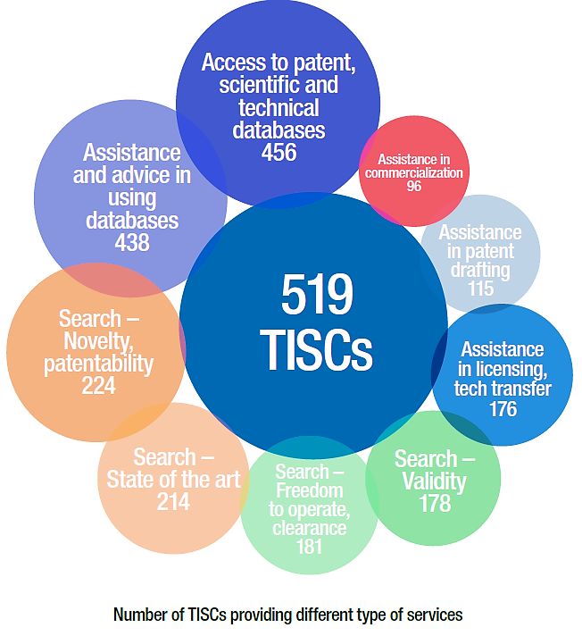
What’s tech?
What are the roles of WIPO?
3
Technology and Innovation Support Centers (TISCs)
LDCs &
Tech Transfer
Institutional and infrastructural function established in respond to the need of accessing technical & scientific information designed under the leadership of Dr. Francis Gurry – WIPO DG
> Core Services
Access to patent & non-patent databases
Concept of AP
Assistance in using database
> Additional Services
(based on user need and office capacity)
Technology Search Services
AP at a glance
Patent Analytical Services
Awareness-raising & Training Services
Role of WIPO
Provide the local research and business community with expert assistance
in the effective retrieval of technological information including resources
such as online access to patent, scientific and technical journal databases.
Notes:
The RTG has decided on basic parameters for the range of solutions to be considered:
Utilize private sector, profit motivation and market forces to attract investment, technology and forward looking, professional management.
Align the incentives among the incumbent farmers, the RTG and the agribusinesses in order to reduce risk.
Organizing the farmers and Agricultural Sponsors (agribusinesses) into companies and/or contractual arrangements that operate through the full value chain will facilitate participation of targeted households in the market opportunities.
Provide farmers with the following:
-Incentives to participate in restoring and working the land over the long term;
-A significant share of the increase in income that will result from enhancing the productivity of the land and sustainability of farming practices;
-Safety nets to insure that their income does not fall below current levels, and to insure that their long term leasehold interest in the land is protected. -For example, the corporate parent of each of the private AG Sponsors who join hands with the farmers to improve and work a sub-parcel of the land, will guarantee that farmers' land lease rights are protected at all times. In an event of default, the farmers’ sub lease to the AG Sponsor or to the co-owned entity (ProducerCo) shall be returned to the farmers. The sublease to the ProduceCos will be kept at a third party escrow company.
Governance, to insure performance and adherence to the pledges made by all of the stakeholders, including framers who have a land lease from the Treasury Department;
Participation in governance of the entities which control the farm to market operations, and which oversee the operators;
Guaranteed employment of everyone in the farmer's household who are beyond school-going age.

Slide 19

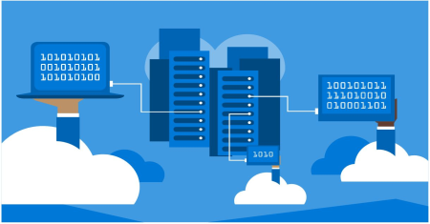
What’s tech?
What are the roles of WIPO?
4
Global IP Databases
LDCs &
Tech Transfer
WIPO also hosts a number of IP and technology databases that make it easier for anyone, anywhere, to access the wealth of information in the IP system.
PATENTSCOPE – allows users to search the technology contained in more than 67 million patent documents. (including international patent applications submitted under the PCT)
Global Brand Database – trademarks, appellations of origin and official emblems from
multiple national and international sources (including marks registered through WIPO’s Madrid System)
Concept of AP
WIPO Lex - one-stop search facility for national laws/treaties on IP of WIPO, WTO & UN Members
Global Re:Search - public access to IP, including pharmaceutical compounds, technologies, data
& know-how available for R&D of Neglected Tropical Diseases (NTDs), Tuberculosis, Malaria.
AP at a glance
> User-friendly
> Fully searchable
> Free of charge
> Easy for anyone, anywhere to access
the wealth of information generated
by the global IP system
Role of WIPO
Notes:
The RTG has decided on basic parameters for the range of solutions to be considered:
Utilize private sector, profit motivation and market forces to attract investment, technology and forward looking, professional management.
Align the incentives among the incumbent farmers, the RTG and the agribusinesses in order to reduce risk.
Organizing the farmers and Agricultural Sponsors (agribusinesses) into companies and/or contractual arrangements that operate through the full value chain will facilitate participation of targeted households in the market opportunities.
Provide farmers with the following:
-Incentives to participate in restoring and working the land over the long term;
-A significant share of the increase in income that will result from enhancing the productivity of the land and sustainability of farming practices;
-Safety nets to insure that their income does not fall below current levels, and to insure that their long term leasehold interest in the land is protected. -For example, the corporate parent of each of the private AG Sponsors who join hands with the farmers to improve and work a sub-parcel of the land, will guarantee that farmers' land lease rights are protected at all times. In an event of default, the farmers’ sub lease to the AG Sponsor or to the co-owned entity (ProducerCo) shall be returned to the farmers. The sublease to the ProduceCos will be kept at a third party escrow company.
Governance, to insure performance and adherence to the pledges made by all of the stakeholders, including framers who have a land lease from the Treasury Department;
Participation in governance of the entities which control the farm to market operations, and which oversee the operators;
Guaranteed employment of everyone in the farmer's household who are beyond school-going age.

Slide 20


Thank you
Notes:
The RTG has decided on basic parameters for the range of solutions to be considered:
Utilize private sector, profit motivation and market forces to attract investment, technology and forward looking, professional management.
Align the incentives among the incumbent farmers, the RTG and the agribusinesses in order to reduce risk.
Organizing the farmers and Agricultural Sponsors (agribusinesses) into companies and/or contractual arrangements that operate through the full value chain will facilitate participation of targeted households in the market opportunities.
Provide farmers with the following:
-Incentives to participate in restoring and working the land over the long term;
-A significant share of the increase in income that will result from enhancing the productivity of the land and sustainability of farming practices;
-Safety nets to insure that their income does not fall below current levels, and to insure that their long term leasehold interest in the land is protected. -For example, the corporate parent of each of the private AG Sponsors who join hands with the farmers to improve and work a sub-parcel of the land, will guarantee that farmers' land lease rights are protected at all times. In an event of default, the farmers’ sub lease to the AG Sponsor or to the co-owned entity (ProducerCo) shall be returned to the farmers. The sublease to the ProduceCos will be kept at a third party escrow company.
Governance, to insure performance and adherence to the pledges made by all of the stakeholders, including framers who have a land lease from the Treasury Department;
Participation in governance of the entities which control the farm to market operations, and which oversee the operators;
Guaranteed employment of everyone in the farmer's household who are beyond school-going age.

